Slide 1
Welcome to the Central 8th Grade Center!
Carie Walter, Principal
Kristine Bushman, Assistant Principal

Slide 2
Policies and procedures
School day 8:12am-2:50pm –building open at 8:00am
Late arriving students must sign in at the office
Call school office to report absences prior to 9:00am
Notify school of any planned vacations/absences
All visitors must report to the main office and sign in
Medication given at school must have a MEDS A Form completed

Slide 3
Policies and procedures
Bullying…reporting
Locker Security
Water is allowed if in a clear plastic bottle/container-no other food or liquid to be consumed outside of lunchroom
Aerosol deodorants or sprays and perfumes
REFER TO THE STUDENT HANDBOOK FOR COMPLETE LIST OF POLICIES AND PROCEDURES

Slide 4
COMMUNICATION
Newsletter sent the last Friday of the month
Includes lunch menu and school calendar
Reminders and other documents sent EVERY Friday via eblast

Slide 5
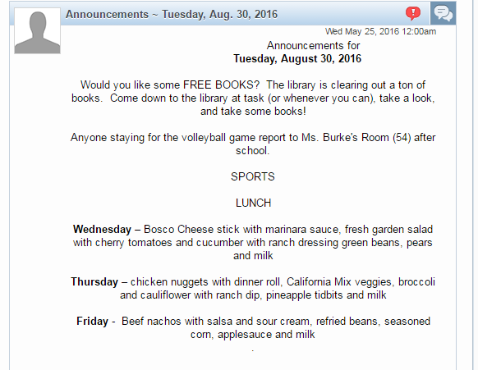
COMMUNICATION
Daily Announcements on Home Screen
Assignments viewable on Skyward Calendar

Slide 6
Naviance delivers easy-to-use research tools that help students assess their areas of interest and learning styles and then helps match them to appropriate college and career options. With Naviance, students, families, and counselors can develop comprehensive roadmaps for student success that allow schools to create individualized course plans for students, facilitate the college application process, survey students, and report and track the outcomes of their entire student population.

Slide 7
College and Career Readiness
October: NAVIANCE and CHS Placement
November: Career Day at CHS
December: CHS Counselor Visit
January: College Day
March: College visit
April: Trades Day

Slide 8
Middle School Promotion, Credit Recovery and HS Placement
12 credits to graduate CMS (20 offered)
Reading or Math Intervention
HS Prep
Credit Recovery Intervention
Edmentum Program
Extended day after school

Slide 9
Standardized Testing
MAP (Measures of Academic Progress)
September, December and April
PSAT
October
PARCC and Illinois Science Assessment
March/April

Slide 10
THANK YOU!!!
We look forward to a successful year with your children.

Slide 11
SESSIONS

